Slide 1









NOTICE: Proprietary and Confidential This material is proprietary to Geocent. It contains trade secrets and confidential information which is solely the property of Geocent. This material is solely for the Client’s internal use. This material shall not be used, reproduced, copied, disclosed, transmitted, in whole or in part, without the express consent of Geocent. © 2009 All rights reserved
Centered on Solutions
Sprint Artifact
GSA 18F BPA Agile RFQ
Drug IQ
Sprint 2 Review and Retrospective
June 25, 2015

Slide 2
Agenda
Goals/Definition of Done
Artifacts: Status
Technologies Chart
Organizational Chart
Architectural Diagrams
Mock Up Issue
Playbook Checklist
Sprint 2 Demonstration
Sprint 2 Stories
Sprint 2 Burndown Chart
Sprint Schedule
Sprint 2 Retrospective

Slide 3
Sprint 2: Prototype Finalization
Goals:
Finalize Architecture
Finalize Prototype Development
Implement Testing Plan and produce report/metrics
Address changes to Mock up
Dependency:
None
Definition of Done: Sprint 2
Prototype completed
Pass testing in Integration branch/CI
Validated Unit Tests
Validated End-to-End Tests
Validated User Acceptance Testing

Slide 4
Sprint 2: Artifacts
Read Me
Update License/Tools/Technologies Chart - Done
https://github.com/Geocent/18f-prototype/blob/integration/README.md
PMP
Org Chart for Project - Done
https://github.com/Geocent/18f-prototype/blob/integration/docs/scrum/sprint2/Geocent%20Project%20Management%20Plan%20-%20Sprint2.docx
Defect/Issue Management Process - Done
https://github.com/Geocent/18f-prototype/blob/integration/docs/scrum/sprint2/Geocent%20Project%20Management%20Plan%20-%20Sprint2.docx
Documentation for CI
Reference Architecture Diagram and add link to PMP
Documentation for CM design
Using GitHub need to add to PMP
Final QA document – Delivery Management Quality Plan
Need meeting to discuss content for PMP
Provide link to Code Review Form

Slide 5
Sprint 2: Artifacts
Architecture Diagram - In progress
https://github.com/Geocent/18f-prototype/blob/integration/docs/scrum/sprint2/architecture-diagram_Sprint2.pdf
UI Mock Up
Need to discuss and document changes made during Prototype development
Playbook Checklist – In progress
Discussion: Change used only Calling drug event – may need to address and redesign to expand events to pull all of the right drugs.

Slide 6
Sprint 2: UI Mock Up
Discussion:
Minor changes made to UI Mock Up for Prototype to present a better view based on usability testing results, technical issues in terms of the number of records being displayed, choosing symptoms before the displays.
Keith and Vance will look at UI based on usability testing results; will create a story for enhancements and prioritize tasks based on feedback.

Slide 7
Sprint 2: Playbook Checklist
https://github.com/Geocent/18f-prototype/tree/integration/docs/HCD
Discussion:
Well covered and good justifications and not applicable identified
Needs review docs.hcd
Add to readme – playbook link and justifications

Slide 8
Sprint 2: Demonstration

Slide 9
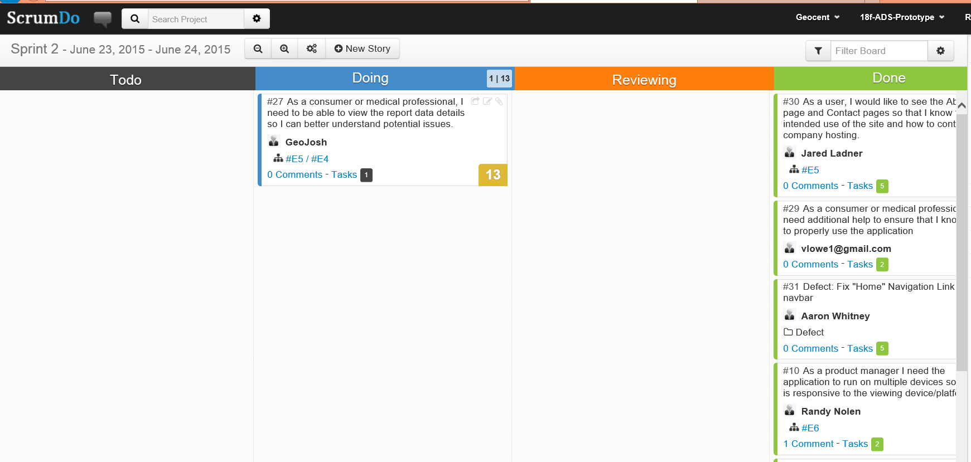
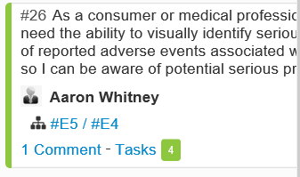
Sprint 2: Stories
https://www.scrumdo.com/projects/project/18f-ads-prototype/iteration/128771
Discussion:
Stories
#31 – look at color scheme when hovering over link
#10 – runs on multiple devices, mobile driver needs adjustments, create enhancements
#26 – check box for seriousness works well
All other stories look good
#27 – working
Acceptance
All completed stories accepted
1 story still in progress
Enhancements
Click view report – opens – only 1 data field, need additional fields to report

Slide 10
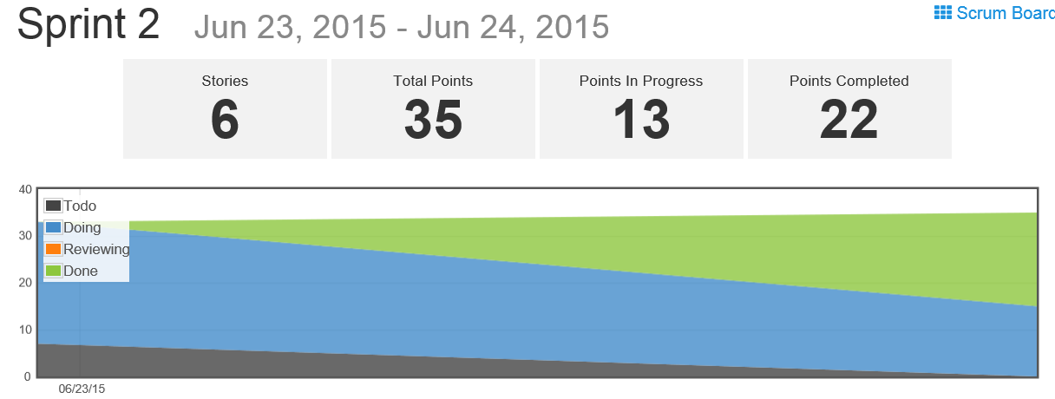
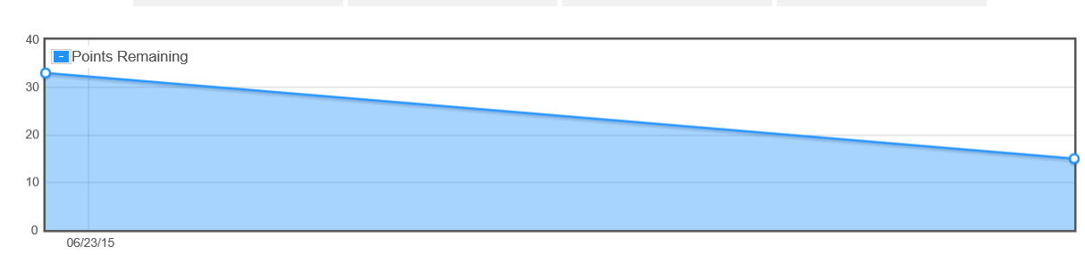
Sprint 2: Burndown Chart
https://www.scrumdo.com/projects/project/18f-ads-prototype/iteration/128771

Slide 11
Sprint Schedule
Sprint 0 – Capture Sprint
6/17/2015
Sprint 0 Planning: 6/17
Sprint 0 Review: 6/18
Sprint 1 – Architecture, Development, Testing
6/18/2015 – 6/22/2015
Sprint 1 Planning: 6/18
Sprint 1 Review: 6/23
Sprint 2 – Finalize Product, Final QA Testing, User Testing
6/23/2015 – 6/24/2015
Sprint 2 Planning: 6/23
Sprint 2 Review: 6/25
Sprint 3 – Usability Enhancement
6/25/2015 – 6/29/2015
Sprint 2 Planning: 6/25
Sprint 2 Review: 6/29
Sprint 3 – Stabilization Sprint
6/29/2015
Deliver
7/1/2015
Completed
Completed
Completed

Slide 12
Sprint 2: Retrospective
What went well?
Instant feedback on CI ADS-Dev – was great, as soon as commit, was available to look at, way it should be
Infrastructure was awesome
Adapted to issues rapidly – made UI, functional issues – pretty responsive
Chat ability went steady all day allowing for rapid reactive changes
Emails from broken builds – immediately know something went wrong – generated from Jenkins CI
User Acceptance Testing issues/bugs/changes into GitHub allowed for instant feedback and changes could be made
High success patch rate
What did not go well?
Skype for business is a challenge for meetings
Merge into integration steady stream of check-in into integration – challenge ready to check-in but someone made changes, had to take a step back (find happy medium to mitigate the challenge), may need more servers, Jenkins job or add process to slow down features into CI – solution: need to pull down updates before commit
Code review process needed, should be id in project kick-off – code related stories, add task for code review, we did have it as definition of done
What would you change?
CI for every feature branch (Ok on large project, not sure of feasibility for smaller projects)
Need a check-in the code review form earlier in process

Slide 13

Questions

Slide 14


